Slide 1
Human Endocrine System
To control and coordinate the internal environment with the changing external environment.

Slide 2
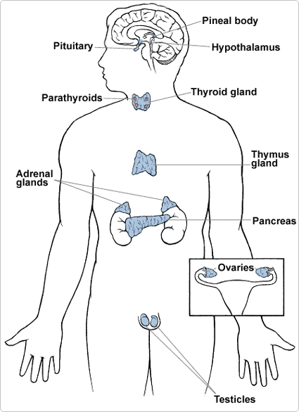

Slide 3
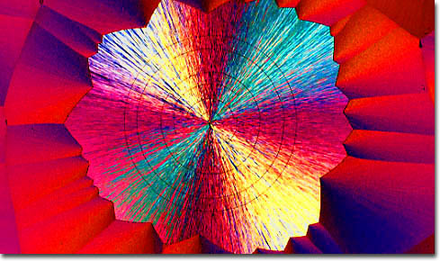
Hormones
Chemical messengers of the endocrine system that travel in the bloodstream.

Slide 4
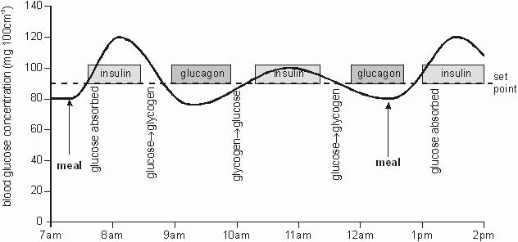
Feedback Mechanism
How hormones work in your body

Slide 5
Homeostasis Imbalance
Hypersecretion = producing too much of the hormone
Hyposecretion = producing too little of the hormone

Slide 6
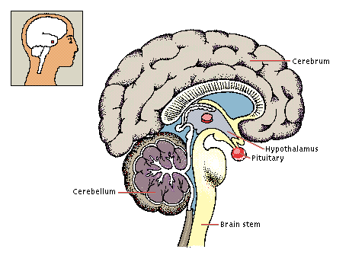
Pituitary Hormones
GH – Growth Hormone
TSH (thyroid stimulating hormone)
FSH (follicle stimulating hormone)
LH (luteinizing hormone)
Prolactin
Oxytocin

Slide 7
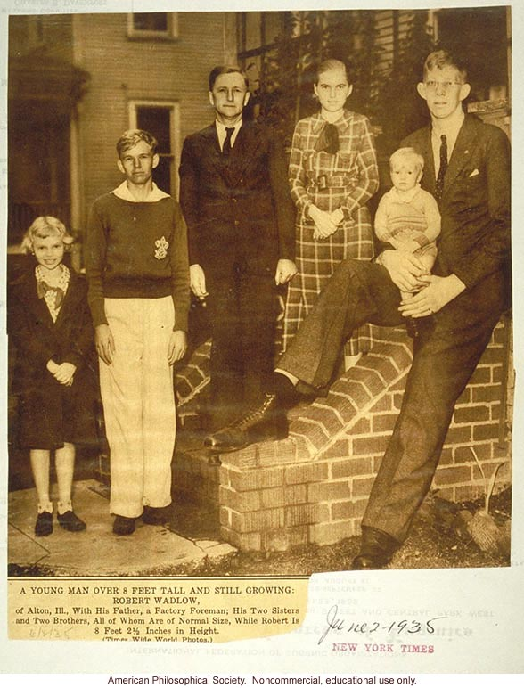
Hypersecretion of GH/Gigantism
Occurs at infancy

Slide 8
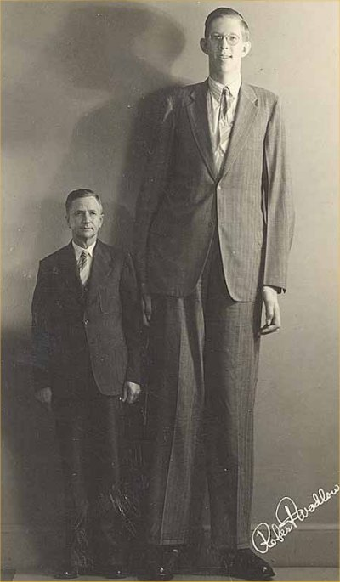
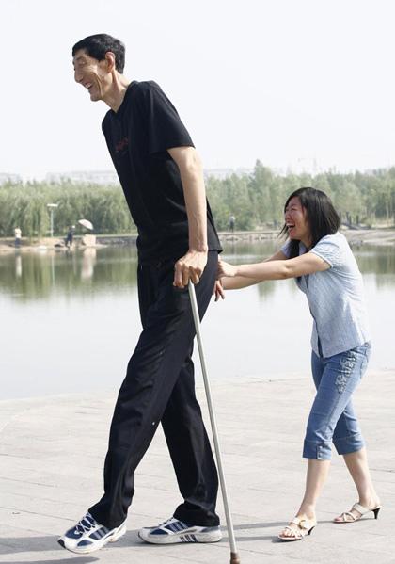

Slide 9
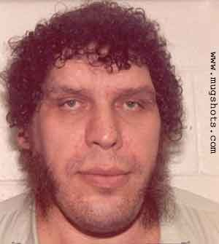
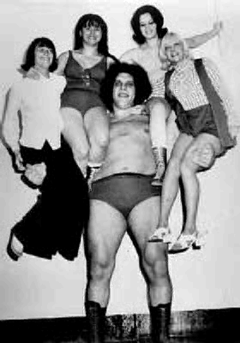
Hypersecretion of GH/Acromegly
Occurs after/onset of puberty

Slide 10
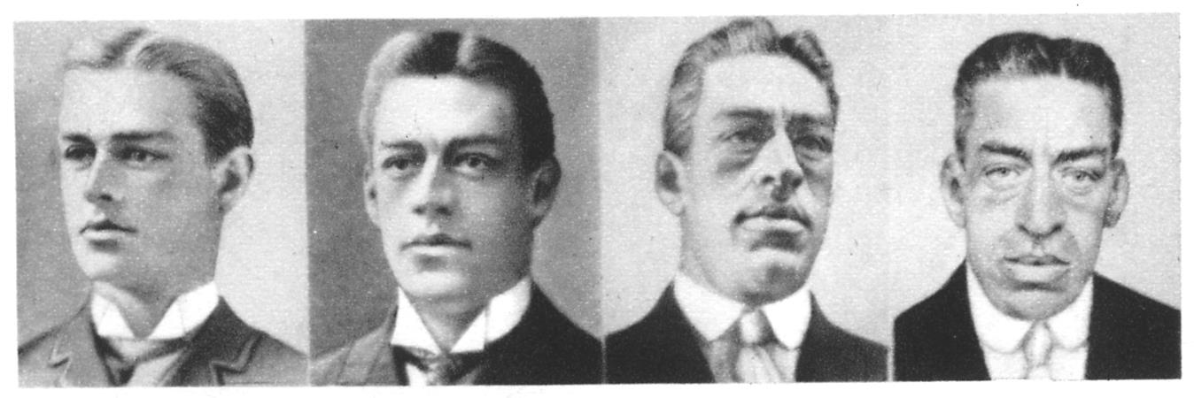
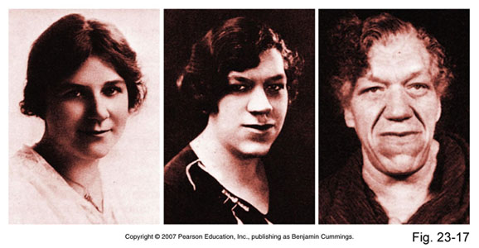

Slide 11
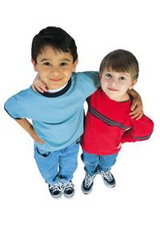
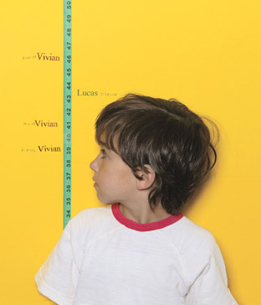
Hyposecretion of GH/Dwarfism

Slide 12
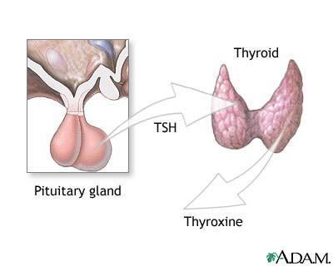
TSH (Thyroid Stimulating Hormone)
Produced by the pituitary gland
Stimulates the thyroid gland to produce thyroxine.

Slide 13
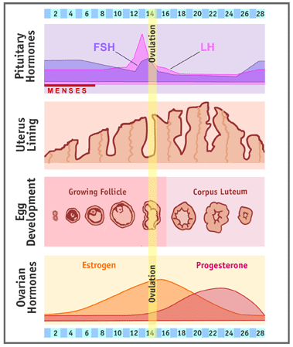
FSH (Follicle Stimulating Hormone)
Produced by the pituitary gland
Stimulates the maturation of the immature follicle (egg) in the ovaries of the female reproductive tract.

Slide 14
LH (Luteinzing Hormone)
Stimulates development of corpus luteum in ovaries and secretion of testesterone in testes.
Ovulation = the release of the egg from the ovary

Slide 15
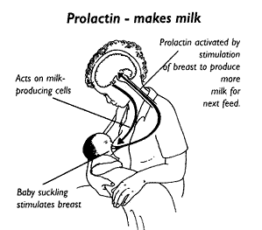
Prolactin
Hormone that stimulates the secretion/production of breastmilk.

Slide 16
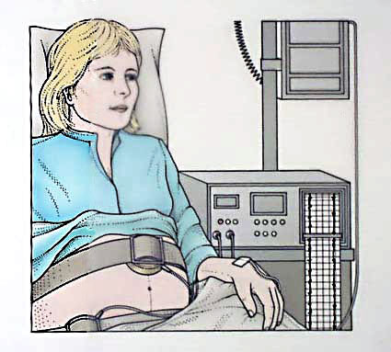
Oxytocin
Hormone that causes contractions of the uterus.
Starts labor
Pitocin = synthetic drug to start/progress labor

Slide 17
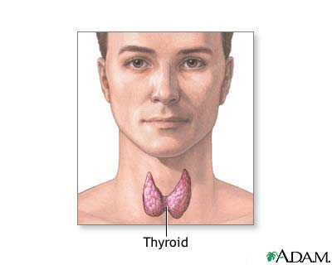
Thyroid Gland
Located in the neck
Produces the hormone thyroxine.
Thyroxine = deals with the metabolic rate

Slide 18
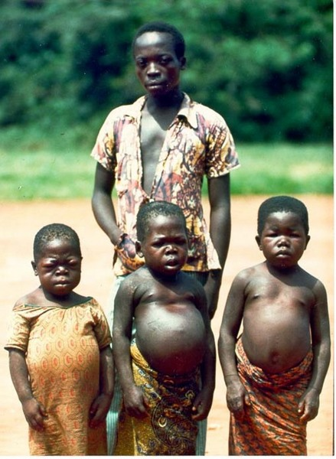
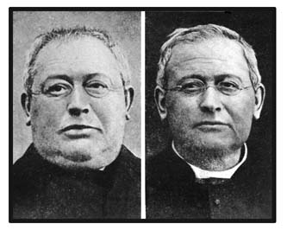
Hypothyroidism
Cretinism
Myxedema

Slide 19
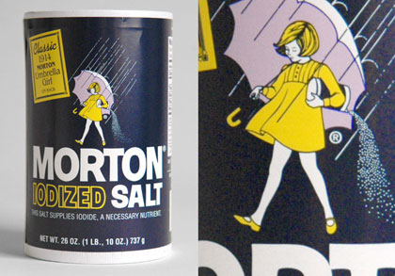
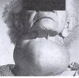
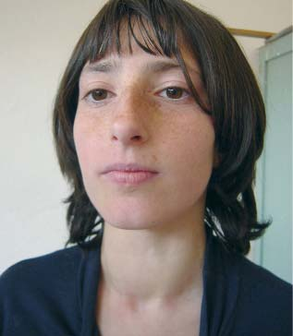
Goiter
Enlargement of the thyroid gland due to the lack of iodine in the diet.

Slide 20
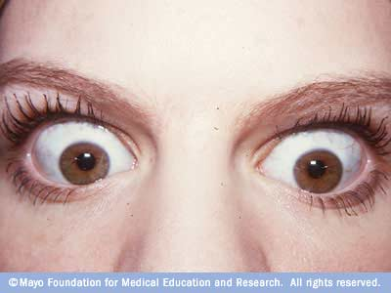

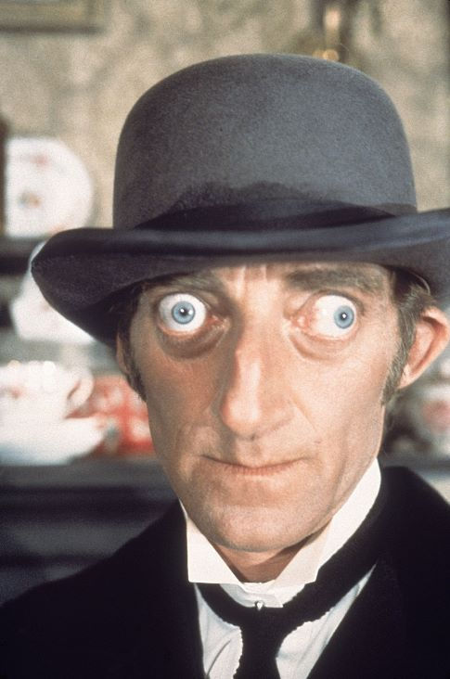
Hyperthyroidism
Graves Disease
Irritability
Difficulty sleeping
Fatigue
Sensitivity to heat
Weight loss, despite normal food intake
Brittle hair
Enlargement of your thyroid gland (goiter)
Light menstrual periods
Frequent bowel movements

Slide 21
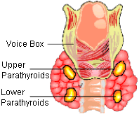
Parathyroid Gland
Produces the hormone parathormone which deals with the balance of phosphorus and calcium

Slide 22
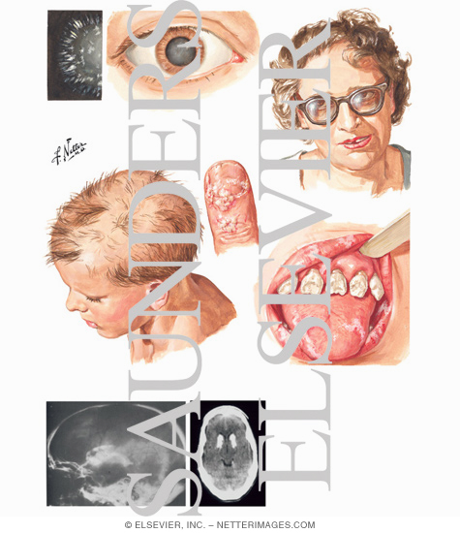
Hypothyroidism

Slide 23
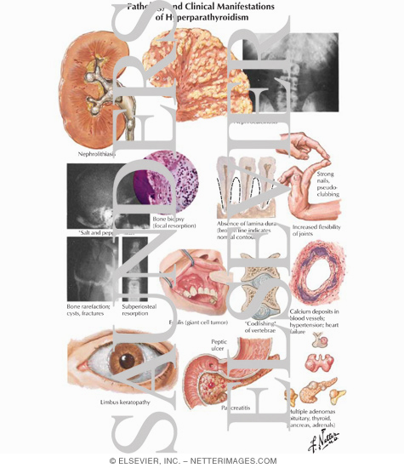
Hyperparathyroidism

Slide 24
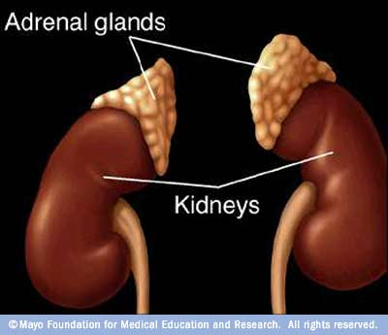
Adrenal Glands
Adrenaline = stimulates breakdown of glycogen to glucose, increase rate of respiration and heartbeat.
Cortin = stimulates breakdown of protein/fat and affect water/salt balance

Slide 25
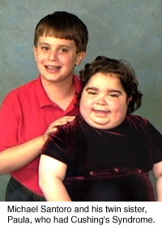
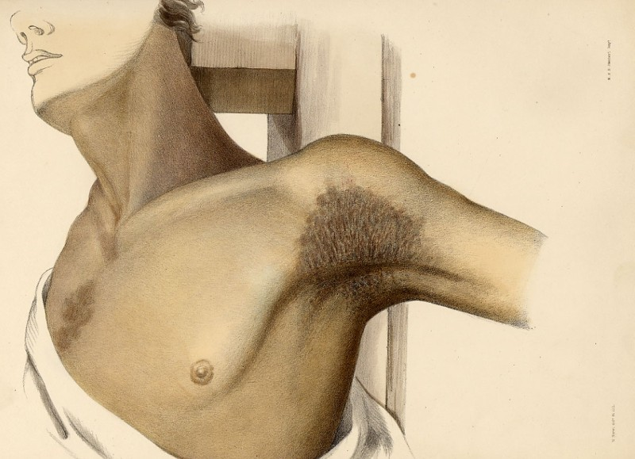
Hyper vs. Hypo
Cushing’s Syndrome
Addison’s Disease

Slide 26
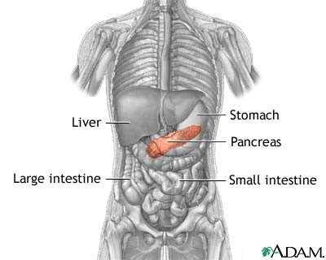
Pancreas-Islets of Langerhans
Produces insulin that lowers blood glucose levels.
Produces glucagon which raises blood sugar levels.

Slide 27
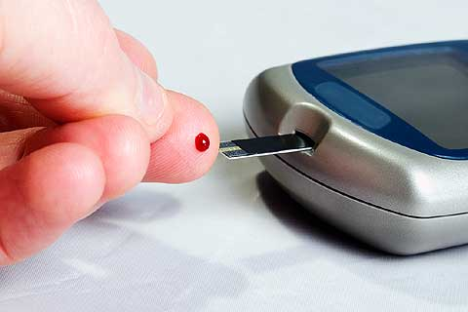
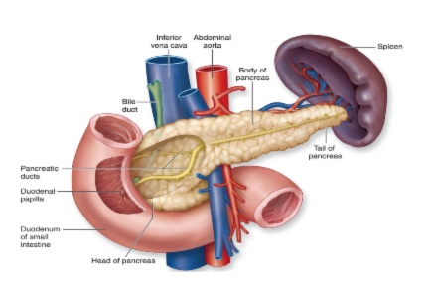
Diabetes/Hyperglycemia
High blood sugar
The pancreas does not produce enough insulin.
Type I: Juvenile diabetes/insulin dependent
Type II: Inefficient Insulin production
Gestational: occurs during pregnancy

Slide 29
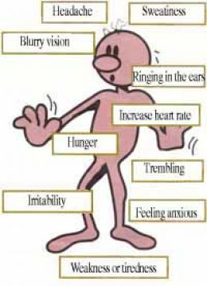
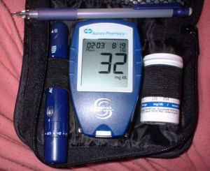
Hypoglycemia
Low blood sugar

Slide 30
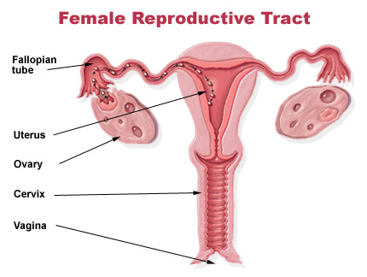
Female Gonads
Female gonads are the ovaries which produce the ovarian hormones of estrogen and progesterone
Menstrual cycle and secondary sex characteristics.

Slide 31
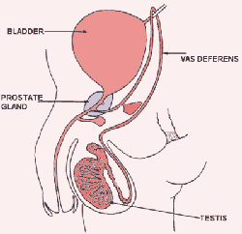
Male Gonads
Male gonads are the testes which produce the hormone testosterone. This hormone help with the production of sperm and development of secondary sex characteristics.

